Slide 1
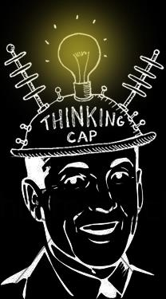
The Thinking Cap
Jennifer Chan and Faraz Sadrzadeh

Slide 2
To be Exact,
Design a
Non-Invasive and Non-Pharmacological Device to
Treat Patients with Cognitive Depression/Dysfunction/Fatigue

Slide 3
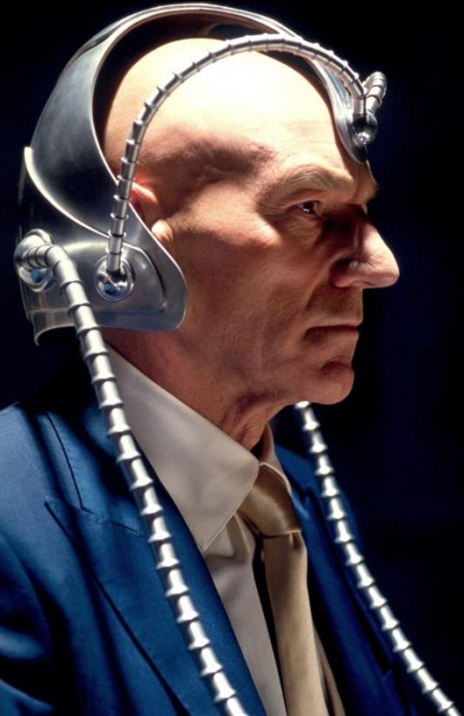
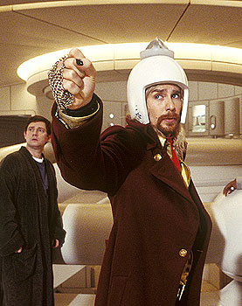
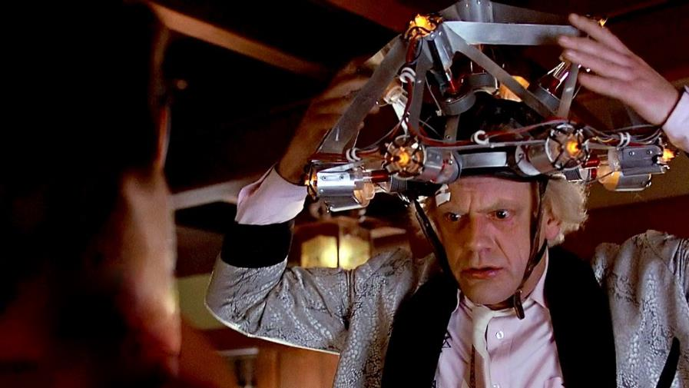
Thinking Caps in pop-culture
Professor Charles Xavier
X-man Series
Zaphod Beeblebrox
The Hitchhikers Guide to the Galaxy
Doc Emmet Brown
Back to the Future

Slide 4
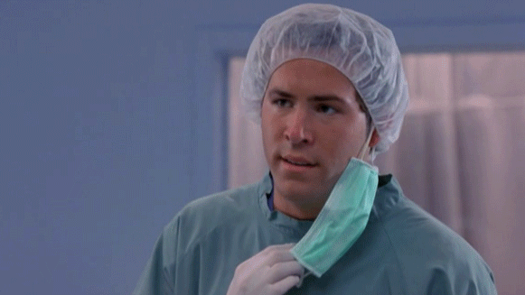

Slide 5
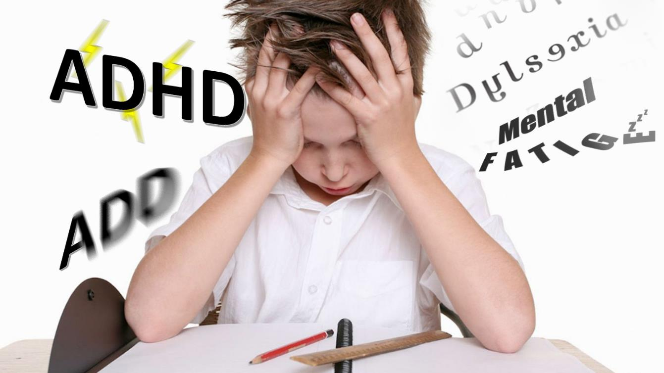
Targeted Users: Children, Teenagers and Adults

Slide 6
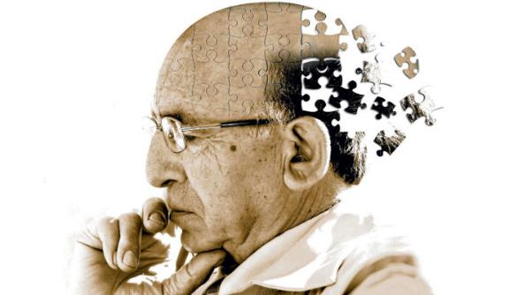
And The Elderly
Alzheimer's Disease
Mild Cognitive Impairment
Dementia
Chronic Fatigue Syndrome
Delirium

Slide 7

ADHD
Attention Deficit Hyperactive Disorder
Neurodevelopmental disorder in children
One of the most commonly diagnosed
Trouble Paying Attention
Impulsive behaviors
Results in poor academic performance

Slide 8
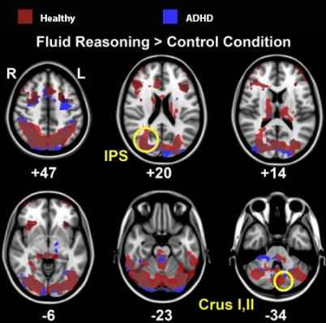
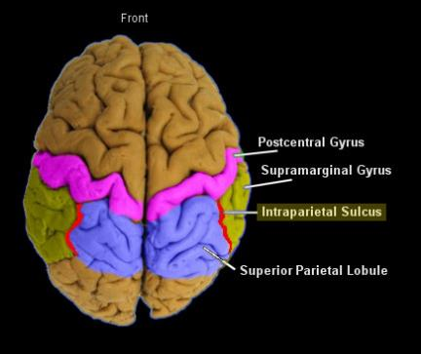
ADHD Anatomy and Physiology
fMRI shows little activity in Intraparietal Sulcus [1]
[1] L. Tame, J. Juranek. “Fluid reasoning deficits in children with ADHD: Evidence from fMRI” in Elsevier Brain Research. Vol. 1465. pp. 48-56, 2012

Slide 9
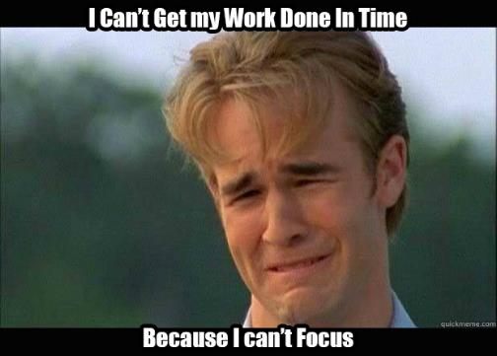
ADD
Attention Deficit Disorder
Mostly diagnosed in teenagers and adults
Lack of focus
Disorganization
Forgetfulness
Lack of motivation

Slide 10
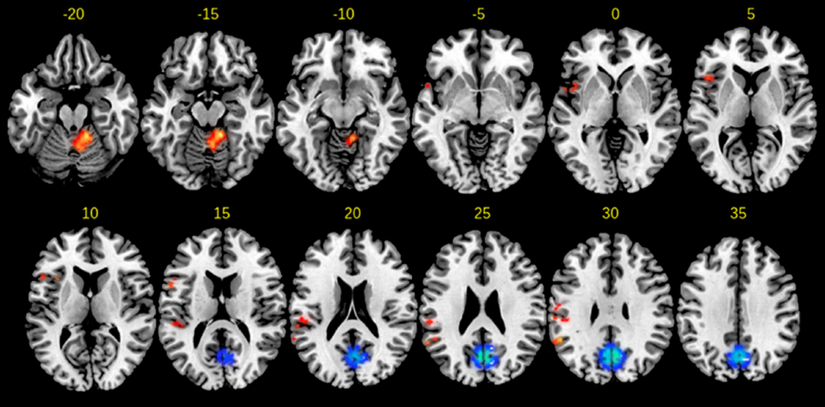
ADD fMRI
Blue represents activation
Red represents inactivity
Compared with healthy individuals [2]
[2] H. Hart, J. Radua, D. Mataix-Cols,
K. Rubia. “Meta-analysis of fMRI studies
of timing in attention-deficit hyperactivity
disorder (ADHD)” in Neuroscience and
Behavioural Reviews – Elsevier. Vol, 36.
pp. 2248 – 2256. 2012

Slide 11
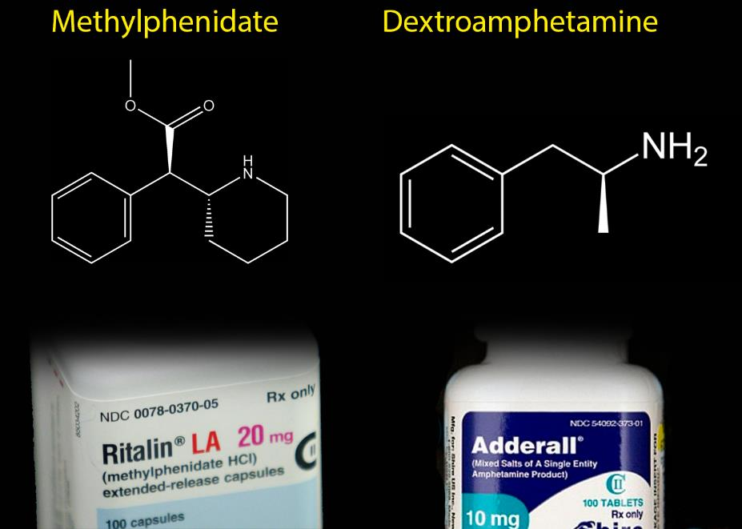
Add and ADHD Popular Pharmaceutical Treatments

Slide 12
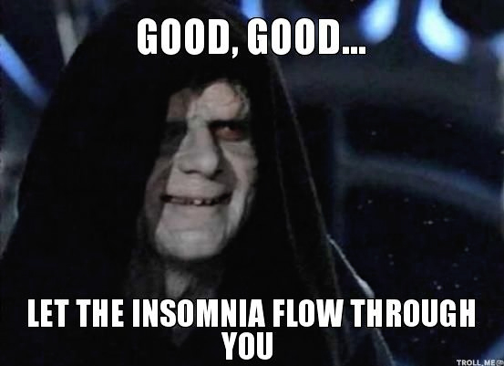
Side Effects
Addiction
Headaches
Loss of Appetite
Insomnia
Restlessness [3]
[3] O. Ogbru, “Adderall Drug Side Effects”. [Online]. 2015. Available:
http://www.rxlist.com/adderall-side-effects-drug-center.htm

Slide 13
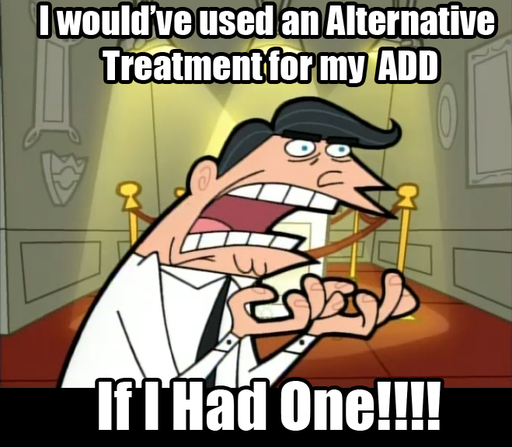
Side Effects
People will seek an alternative treatment if:
They are concerned about the side effects of the known treatments
The known treatments would not work for them

Slide 14

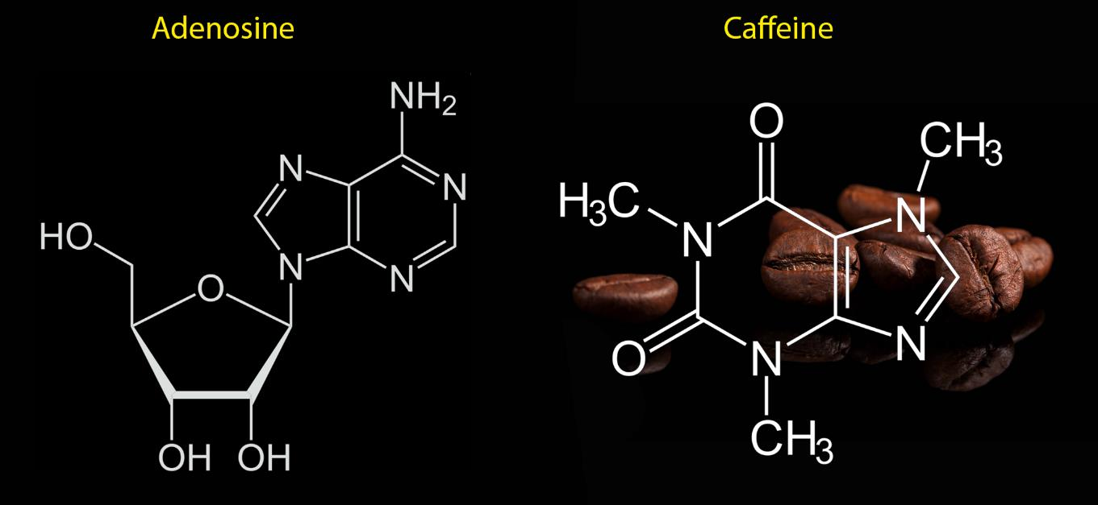
Mental Fatigue
Lack of wakefulness
Mainly the build up of Adenosine in the brain

Slide 15
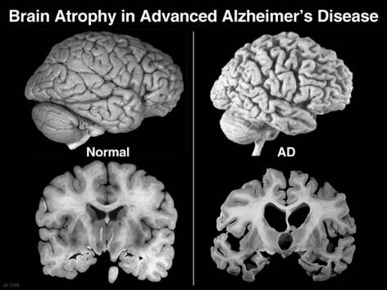
Alzheimer's Disease
Loss of memory
Inability to recognize family and friends
Inability to use short term memory [4]
[4] “Brain Atrophy in Alzheimer's”. [Online Image]. Available:
https://goinggentleintothatgoodnight.files.wordpress.com/2013/06/brain-healthy-brain-ad-best.jpg

Slide 16
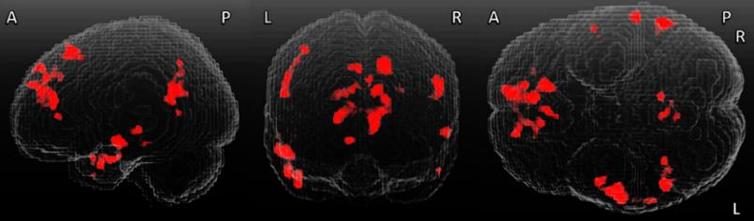
Mild Cognitive Impairment, Dementia, and Delirium
What are they?
Diagnosed in the Elderly
All show a decreased activity in the following regions [5]
[5] Teipel, S. J., Wohlert, A., Heine, C., Grothe, M. J., Grimmer, T., Sorg, C., . . . Dyrba, M. (2016).
FUNCTIONAL CONNECTIVITY IN ALZHEIMER’S DEMENTIA AND MILD COGNITIVE IMPAIRMENT:
A LARGE-SCALE MULTICENTER RESTING-STATE FMRI STUDY. Alzheimer's & Dementia:
The Journal of the Alzheimer's Association,12(Supplement), P38-P38. doi:10.1016/j.jalz.2016.06.055

Slide 17
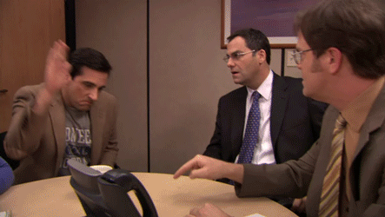
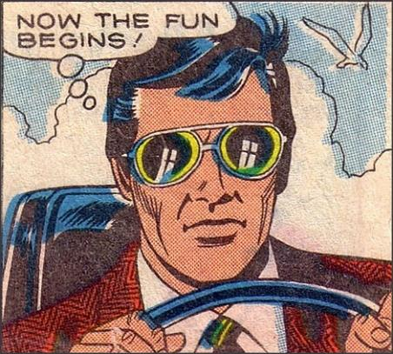
We’ve talked enough about disorders, Let’s move onto the fun part

Slide 18
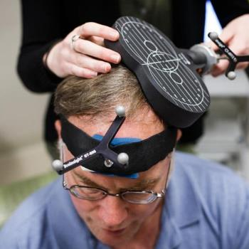
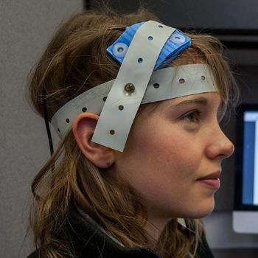
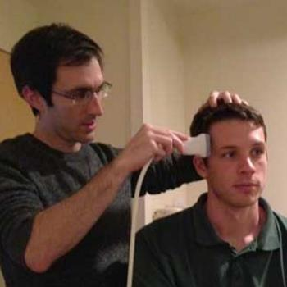
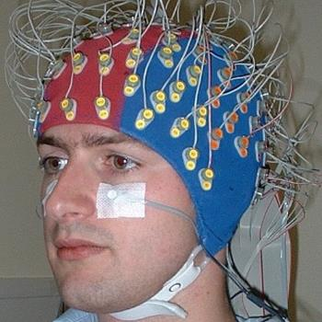
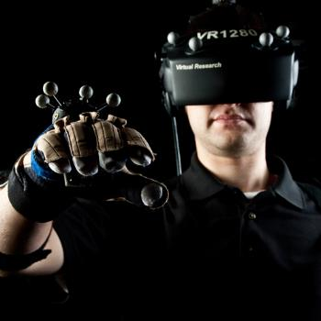
Available Neuro-stimulation Devices
Transcranial
Magnetic
Stimulation [6]
Transcranial
Direct Current
Stimulation [7]
Transcranial
Ultrasound
Stimulation [8]
Neuro-Feedback
[9]
Virtual Reality
And
Audio-Visual
Stimulation [10]
[6] [Online]. Available: https://c.o0bg.com/rf/image_960w/Boston/2011-2020/2016/03/15/BostonGlobe.com/Lifestyle/Images/160314_KDB_TMS_THERAPY_006.jpg
[7] [Online]. Available: http://www.sciencemag.org/sites/default/files/styles/article_main_large/public/images/sn-handednessREV.jpg?itok=qCzi7XjO
[8] [Online]. Available: http://www.robaid.com/wp-content/gallery/medicine-1/ultrasound-brain-2.jpg
[9] [Online]. Available: http://www.biosemi.com/pics/Praamstra_cap2_large.jpg
[10] [Online]. Available: http://channeleye.co.uk/wp-content/uploads/2015/01/virtual-reality.jpg

Slide 19
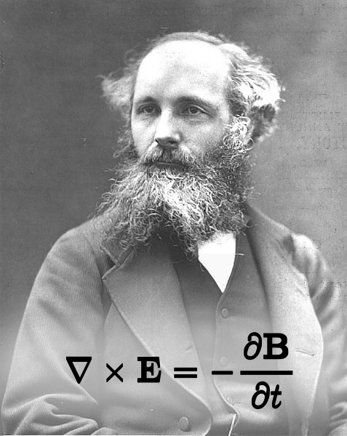
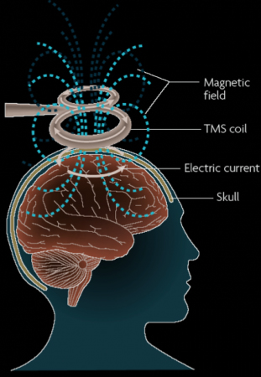
Transcranial Magnetic Stimulation (TMS)
Produce an extreme flux rate in the brain, inducing action potentials [11]
[11] V. Dubljević. Neurostimulation devices for cognitive
enhancement: Toward a comprehensive regulatory framework.
Neuroethics 8(2), pp. 115-126. 2015. . DOI: 10.1007/s12152-014-9225-0.

Slide 20
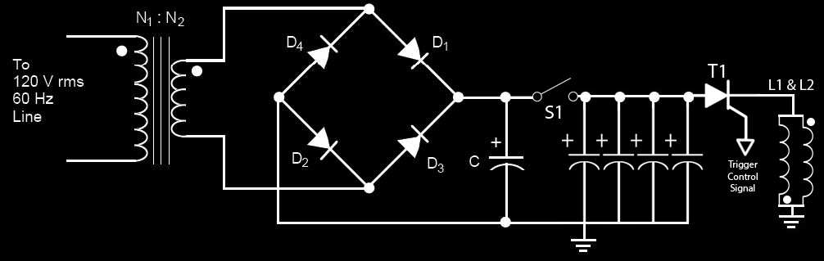
TMS Simplistic Circuitry

Slide 21
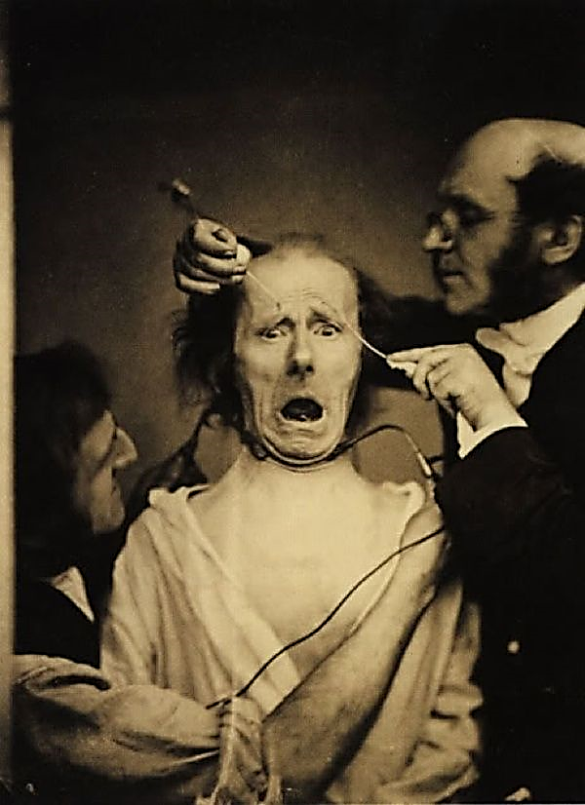
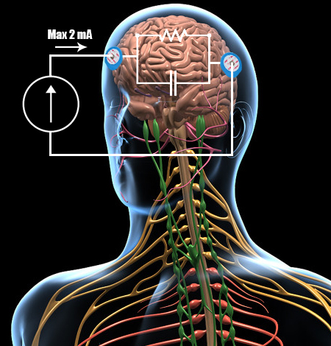
Transcranial Direct Current Stimulation
Pass a small current through the brain, causing action potentials in desired regions
Been Practiced Since the 19th Century [11]

Slide 22
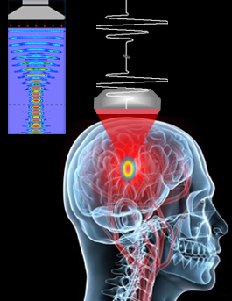
Focused Ultrasound Stimulation
Point multiple ultrasound transducers at the same place
Allow for the waves to converge at a focal point
The micro-vibrations can induces stimulation [11]

Slide 23
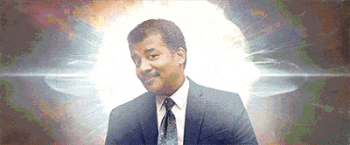

Slide 24
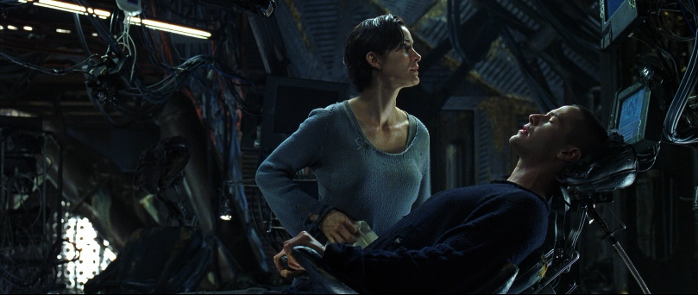
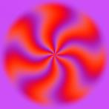
Audio-Visual Stimulation and Virtual Reality
The most rapidly developing neuro-stimulation technology
Use of virtual reality mind games to cause stimulation
Display of colourful patterns and harmonic sounds to cause stimulation [11]

Slide 25
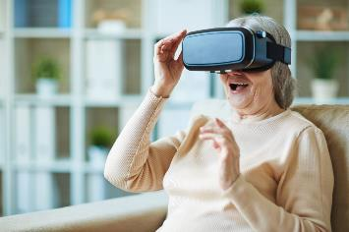
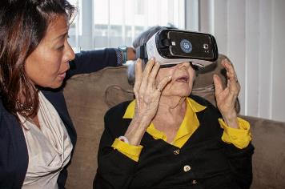
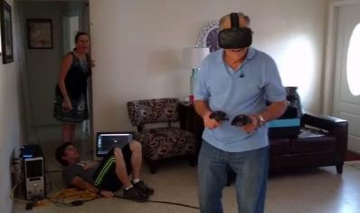
virtual Reality Cont.
Most useful to train and rehabilitate the mind of the elderly to regain memory, spatial awareness, coordination, cognition, and the perception of reality [11]
Popular virtual reality headsets: HTC Vive®, and Oculus Rift

Slide 26
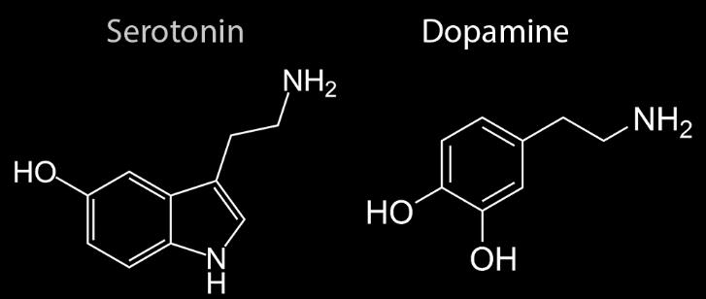
What is Stimulation in our context?
Direct or indirect release of stimulatory Neurotransmitters
Indirectly by activating a neural pathway that leads to the release [11]
Serotonin and Dopamine

Slide 27
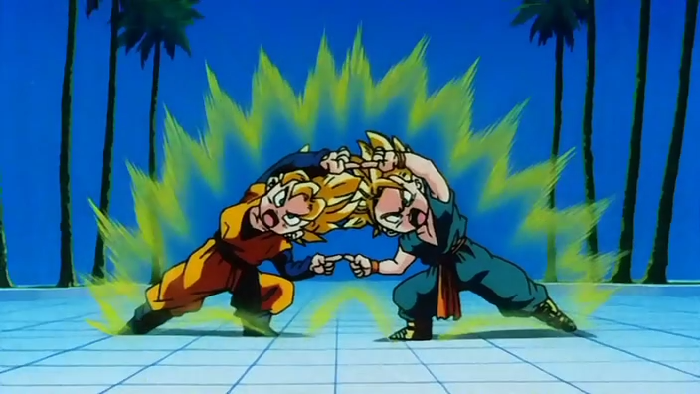
Now All Unite!

Slide 28
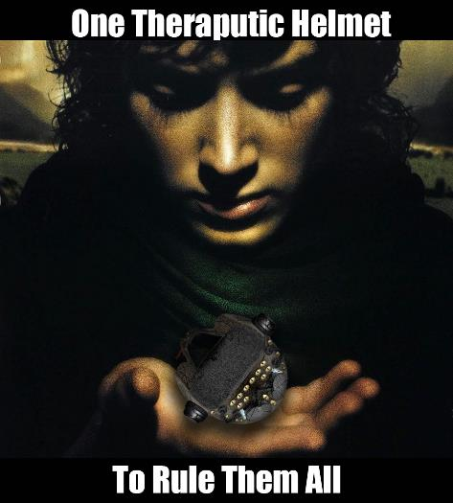

Hybridization of all Those Technologies

Slide 29
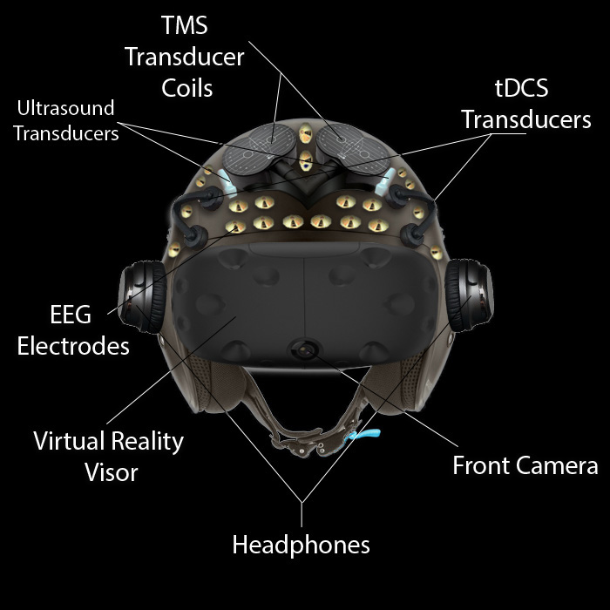
Functional Units

Slide 30
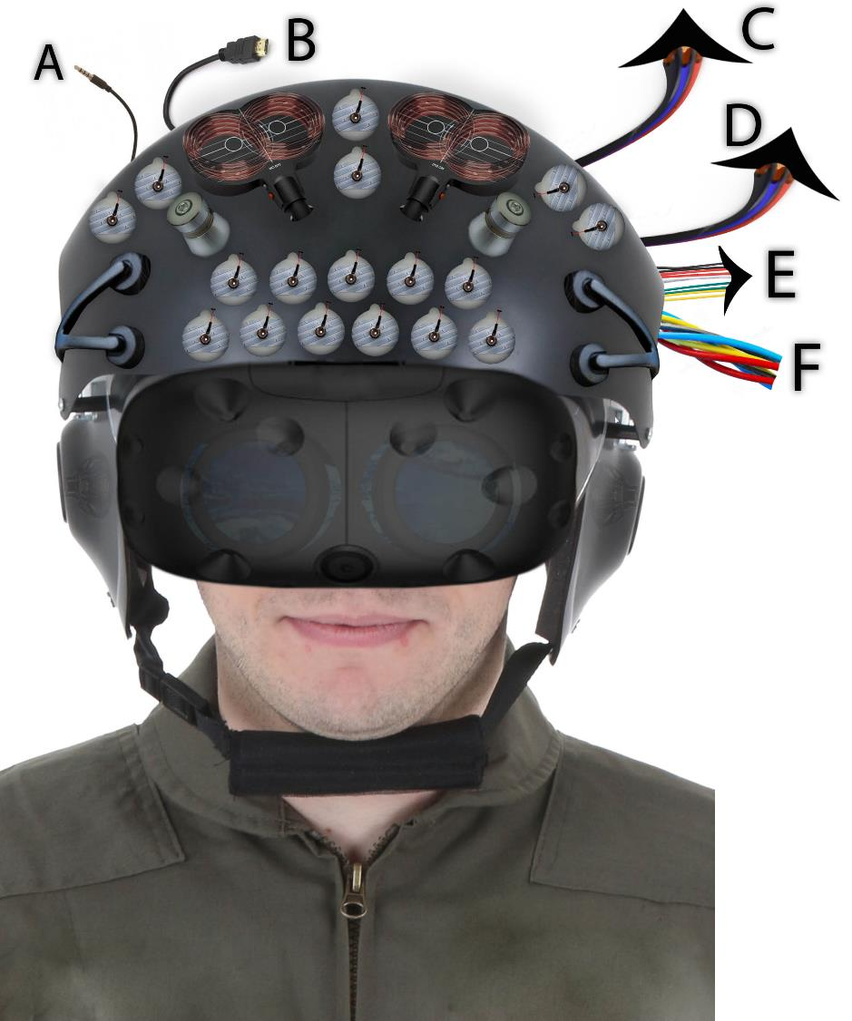
Audio Input
Virtual Reality Video Input
Ultrasound Transducer Modulated Power Line
TMS Current Carrying Cables
EEG Output
tDCS Inputs

Slide 31
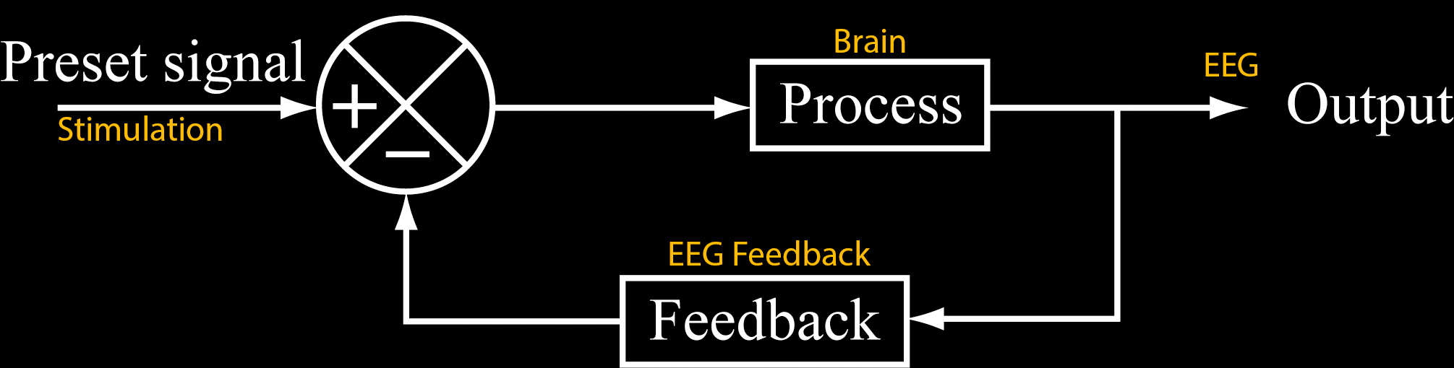
Neuro-feedback
Collect EEG signals and modify the stimulation patterns in real time based on the EEG feedback

Slide 32
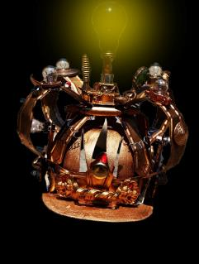
Effectiveness of the Technologies
All of the methods mentioned, were proven to be effective to some extent, but with varying results and conclusions [12]
tDCS and TMS are known to be the most effective in the treading and the rehabilitation of the elderly [12]
Virtual Reality is proving itself worthy [12]
[12] V. Gálvez, K. Ho, A. Alonzo, D. Martin, D. George and C. K. Loo.
Neuromodulation therapies for geriatric depression. Current Psychiatry Reports 17(7),
pp. 1-15. 2015. . DOI: 10.1007/s11920-015-0592-y.

Slide 33
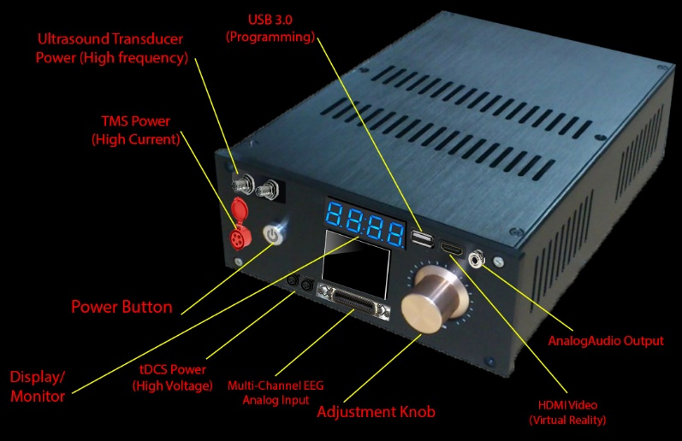
Chassis For Controlling The Helmet

Slide 34
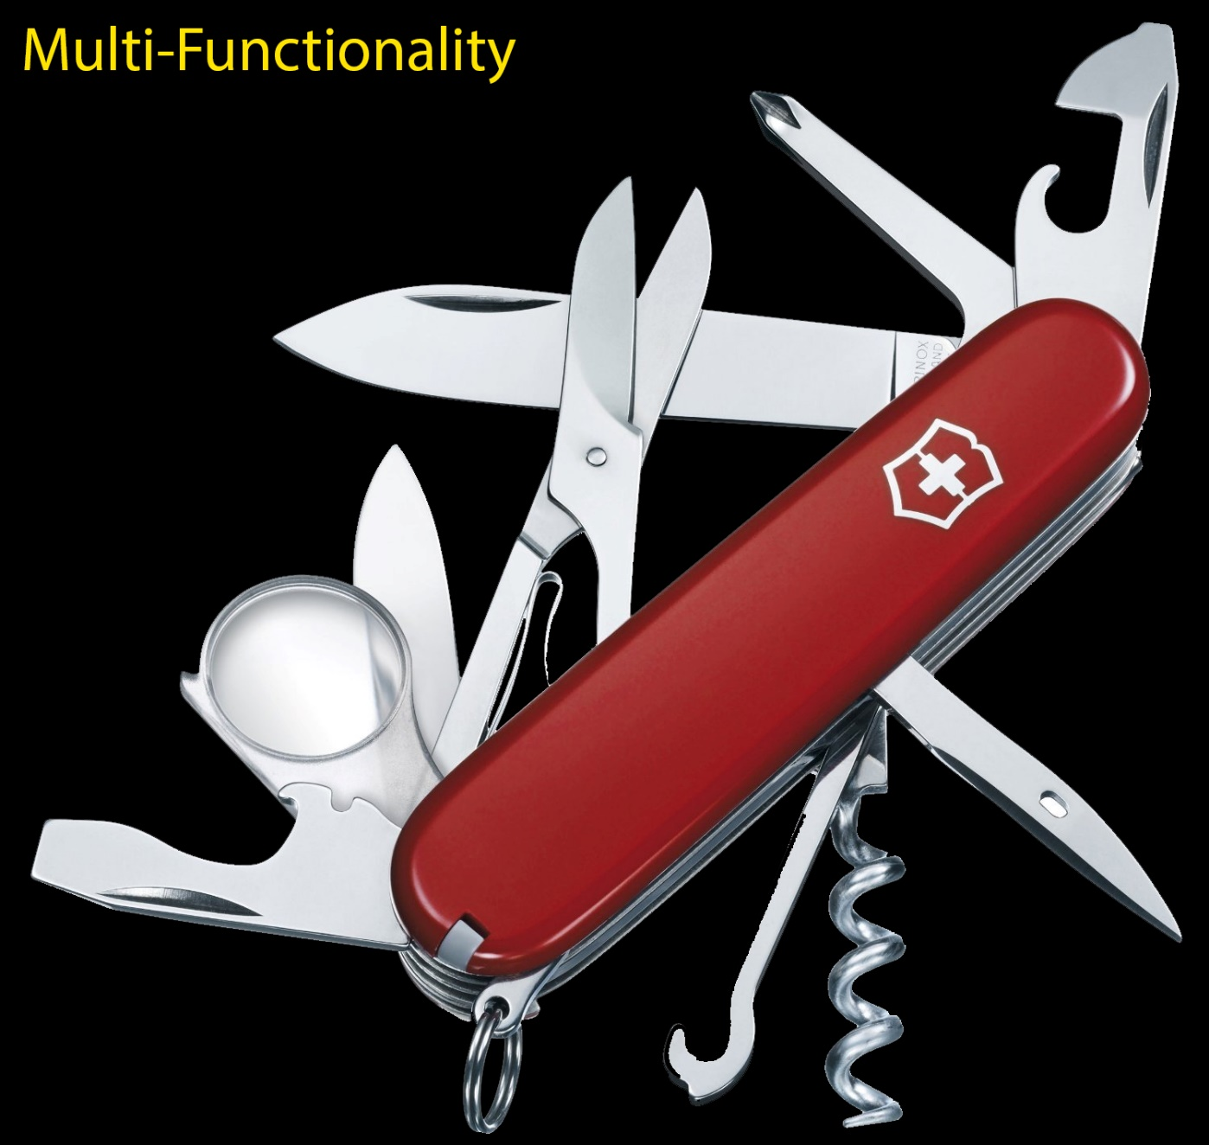
Features
Versatile with many degrees of freedom
Programmable
Safety shutdown in case of abnormal EEG
Different modes of operation
Fast stimulation
Wireless connectivity
EEG analysis

Slide 35
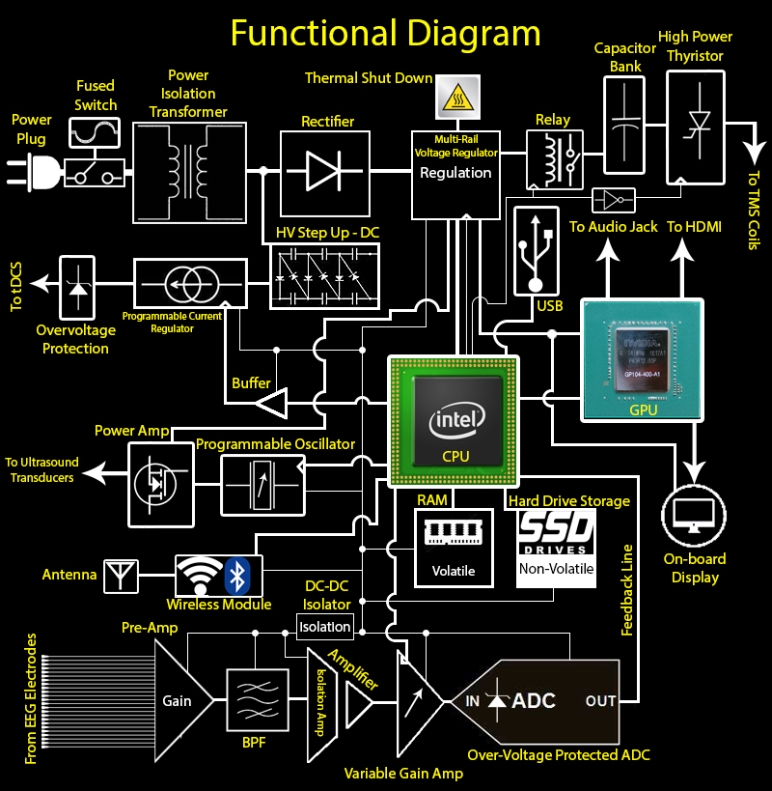

Slide 36
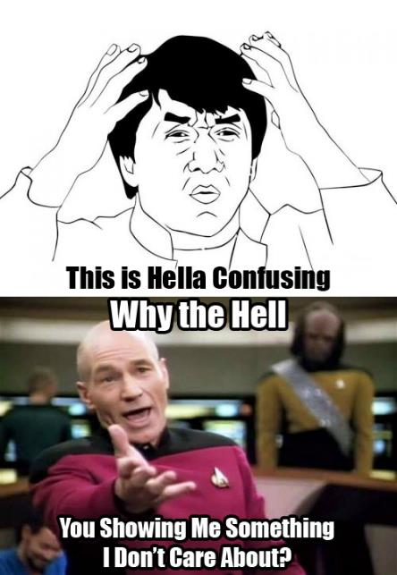

Slide 37
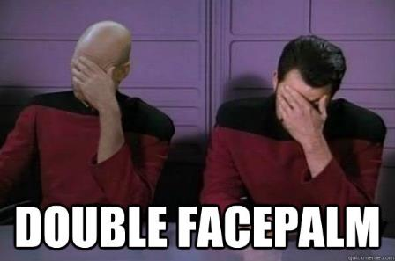
Disadvantages
The Chassis is bulky and heavy
The helmet is bulky, heavy, unaesthetic
If not used properly, it can cause permanent damage [11]
Some methodologies used are not thoroughly researched and refined
People taking anti- depressants can be badly hurt [11]
Long term side effects are mostly unknown
Its effects in children are unknown [12]
Very expensive

Slide 38


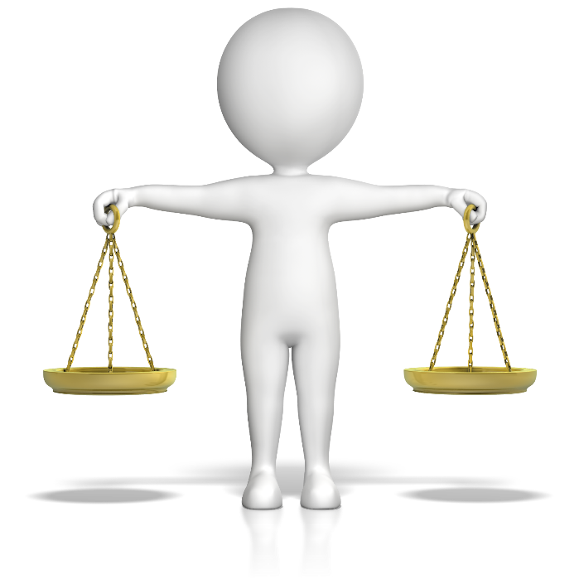
Clinical trials
Qualified investigator
Monitoring sponsor
Ethics Review Board

Slide 39
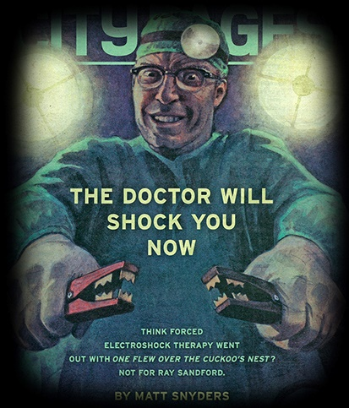

Slide 40

Ethical considerations
Safety
Character
Autonomy
[13] Hamilton, R., Messing, S., & Chatterjee, A. (2011). Rethinking the thinking cap Ethics of neural enhancement using noninvasive brain stimulation.Neurology, 76(2), 187-193.

Slide 41
what do we need to prioritize?
PARTICIPATORY RESEARCH
No physical harm
Not driven by industry
Fully informed users
[14] Burstow, B. (2016). Legitimating Damage and Control: The Ethicality of Electroshock Research. Intersectionalities: A Global Journal Of Social Work Analysis, Research, Polity, And Practice, 5(1), 94–109. Retrieved from http://journals.library.mun.ca/ojs/index.php/IJ/article/view/1408

Slide 42

Now what?

Slide 43




What does class iii mean?
Notes:
Class III devices usually sustain or support life, are implanted, or present potential unreasonable risk of illness or injury. They have the toughest regulatory controls. Most of these devices require Premarket Approval because general and special controls alone cannot reasonably assure their safety and effectiveness.
Examples: pacemakers, implanted weight loss devices, non-invasive glucose testing devices, medical imaging analyzers, cochlear implants, breast implants

Slide 44
FDA Application
General Controls
Premarket approval

Slide 45



Currently existing patents
Methods and apparatus for transcranial stimulation
Fixture of the Head for Transcranial Magnetic Stimulation
Robotic apparatus for targeting and producing deep, focused transcranial magnetic stimulation
[15] Schneider. "Robotic Apparatus For Targeting And Producing Deep, Focused Transcranial Magnetic Stimulation". 2009: n. pag. Print.
[16] Saitoh. "Fixture of the Head for Transcranial Magnetic Stimulation and Transcranial Magnetic Stimulator". 2009: n. pag. Print.
[17] Simon. "Methods and apparatus for transcranial stimulation". 2009: n. pag. Print.

Slide 46

What is the depression treatment market trend?
2013:
$22.5 billion USD
Blockbuster prescription drug patents are about to expire!
But the number of people requiring cognitive treatments isn’t changing…
2020:
$18.2 billion USD
[18] Transparency Market Research (2016). Global Anxiety Disorders and Depression Treatment Market to Decline due to Patent Expiration of Blockbuster Drugs. Retrieved from http://www.transparencymarketresearch.com/pressrelease/global-anxiety-disorders-depression-treatments.htm

Slide 47

THANK YOU!
Any Questions?

